Slide 1

Lightweight coding in powerful Cloud Development Environments

Slide 2






Lightweight coding in powerful Cloud Development Environments
Linux VM
Linux VM
DigitalXchange – 3rd June 2023
Lucas Jellema, CTO & Architect Conclusion
Notes:
Cloud Based Development environments allow software engineers to work in a new and refreshing way. The development environment runs in the cloud, based on a coded environment definition and with the sources from a specific branch in a Git repository. The environment can be quite powerful in memory, CPU and storage. Development can be done from a lightweight device such as a Chromebook or even a tablet. Switching between different environments becomes a breeze, collaborating in an environment is easily done. Using network tunneling, the IDE could run locally against the remote workspace and remote ports can be accessed on localhost. This session demonstrates both Gitpod and Github Codespaces - similar SaaS offerings with generous free tiers. They are great for quick investigation into new technologies, for working through tutorials and for contributing to open source projects. You will smile at the ease and elegance of engineering your software in this way.

Slide 3
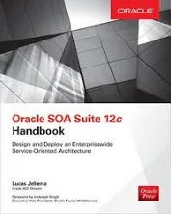
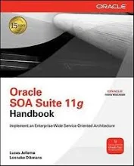
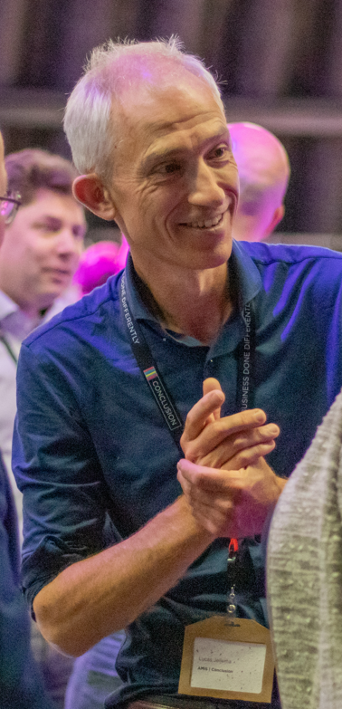
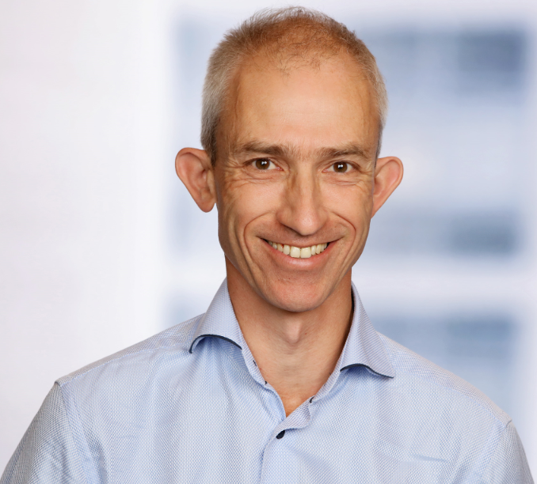


Architect on many integration initiatives with dozens of large and small organizations in The Netherlands
Oracle ACE Director, Java Rockstar, author of two books on integration
frequent speaker on conferences & active blogger
Lucas Jellema
Cloud Solution Architect & CTO
lucas.jellema@conclusion.nl | technology.amis.nl | @lucasjellema | lucas-jellema

Slide 4
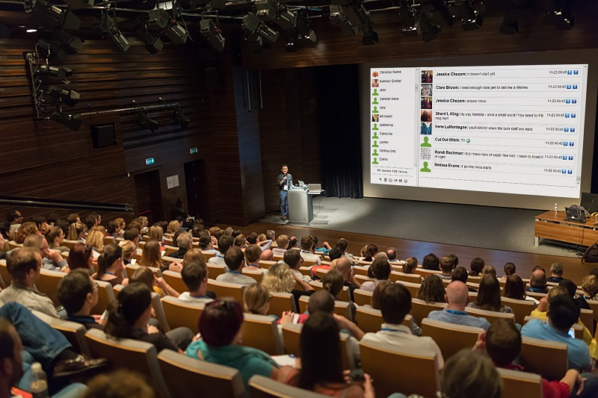



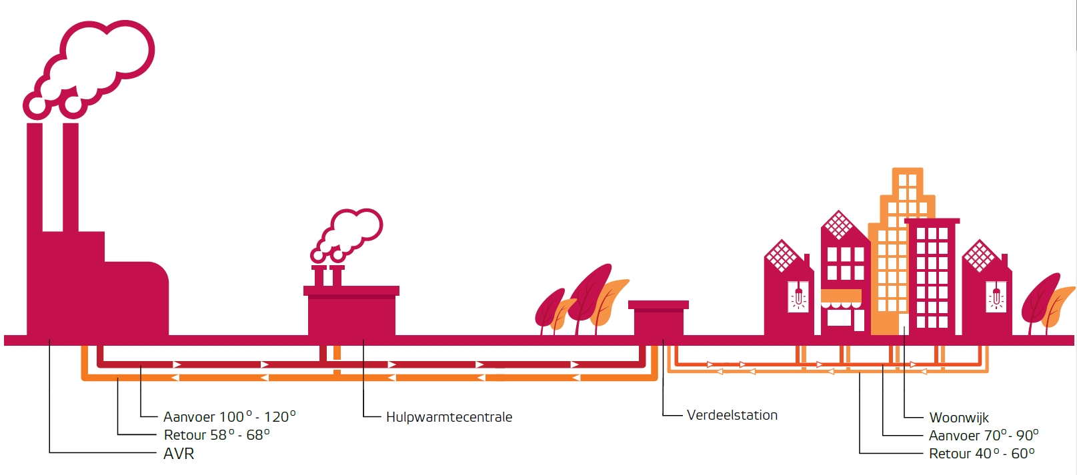

Lecture & Hands on with 150 students
picture of room with QR code on screen
Monitoring
Smart Meter
Communication Module
Ingest, Authenticate & Check
Validate, Enrich Process, Convert, Publish
Event Streaming Platform
Smart Meter
Devices
Telemetry
HEAT
IoT Platform

Slide 5
Lecture & Hands on with 150 students
picture of room with QR code on screen
Monitoring
Communication Module
Ingest, Authenticate & Check
Validate, Enrich Process, Convert, Publish
Event Streaming Platform
Smart Meter
Smart Meter
Devices
Telemetry
HEAT
IoT Platform

Slide 6
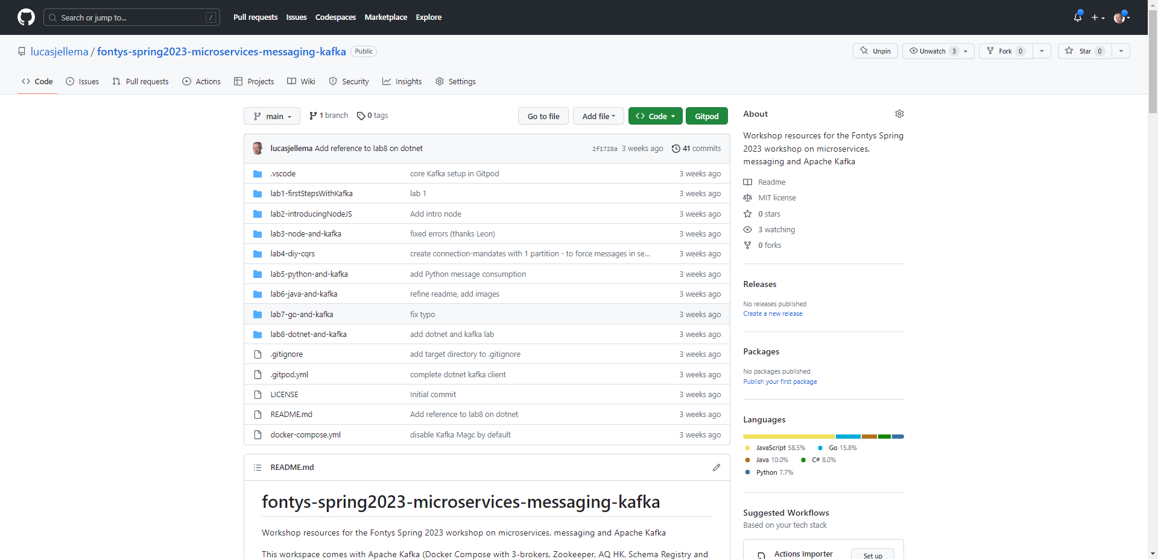
What is the URL?
https://gitpod.io/#https://github.com/lucasjellema/fontys-spring2023-microservices-messaging-kafka
https://gitpod.io/#<URL of a GitHub Repository>

Slide 7
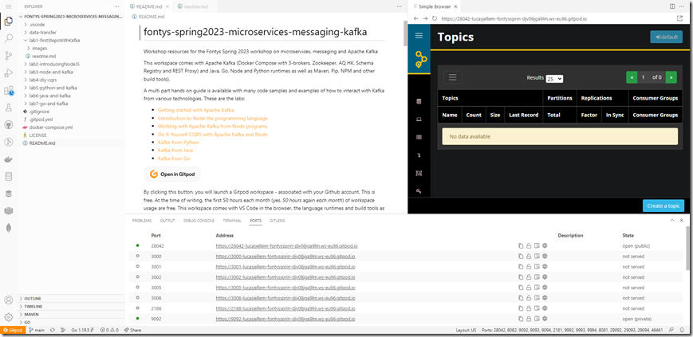
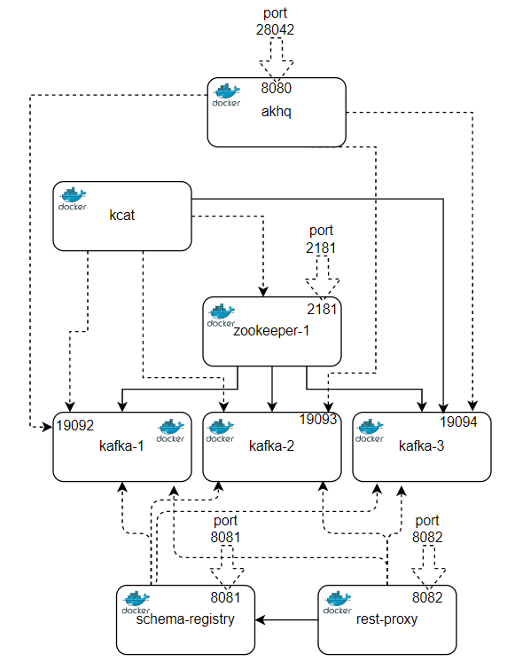
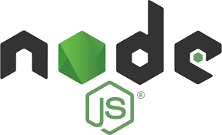





Open QR code, wait five minutes and … action!
Linux environment
Ubuntu 22.04.2 LTS (Jammy Jellyfish)
4 cores, 8GB RAM, 30 GB disk
Docker, Docker Compose
Language Runtimes: Java, Node, Go, C/C++, Python, Ruby, Rust, Clojure
Homebrew, Maven, npm, Tailscale, Nginx, Nix
VS Code in browser
3 node Kafka Cluster running – plus supporting tools

Slide 8


Slide 9
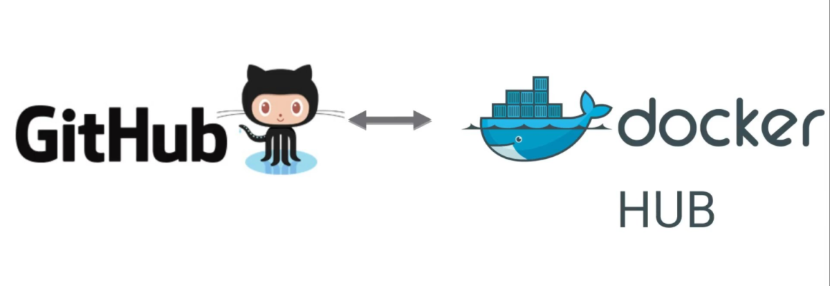


Gitpod
Linux VM
Linux VM
Linux VM
Linux VM
Linux VM
Linux VM
Linux VM
Linux VM
Linux VM
Linux VM
Linux VM
Linux VM
Linux VM
Linux VM
Linux VM
Linux VM
Linux VM
Linux VM

Slide 10
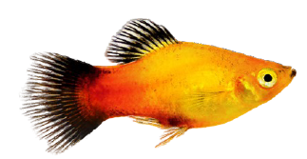
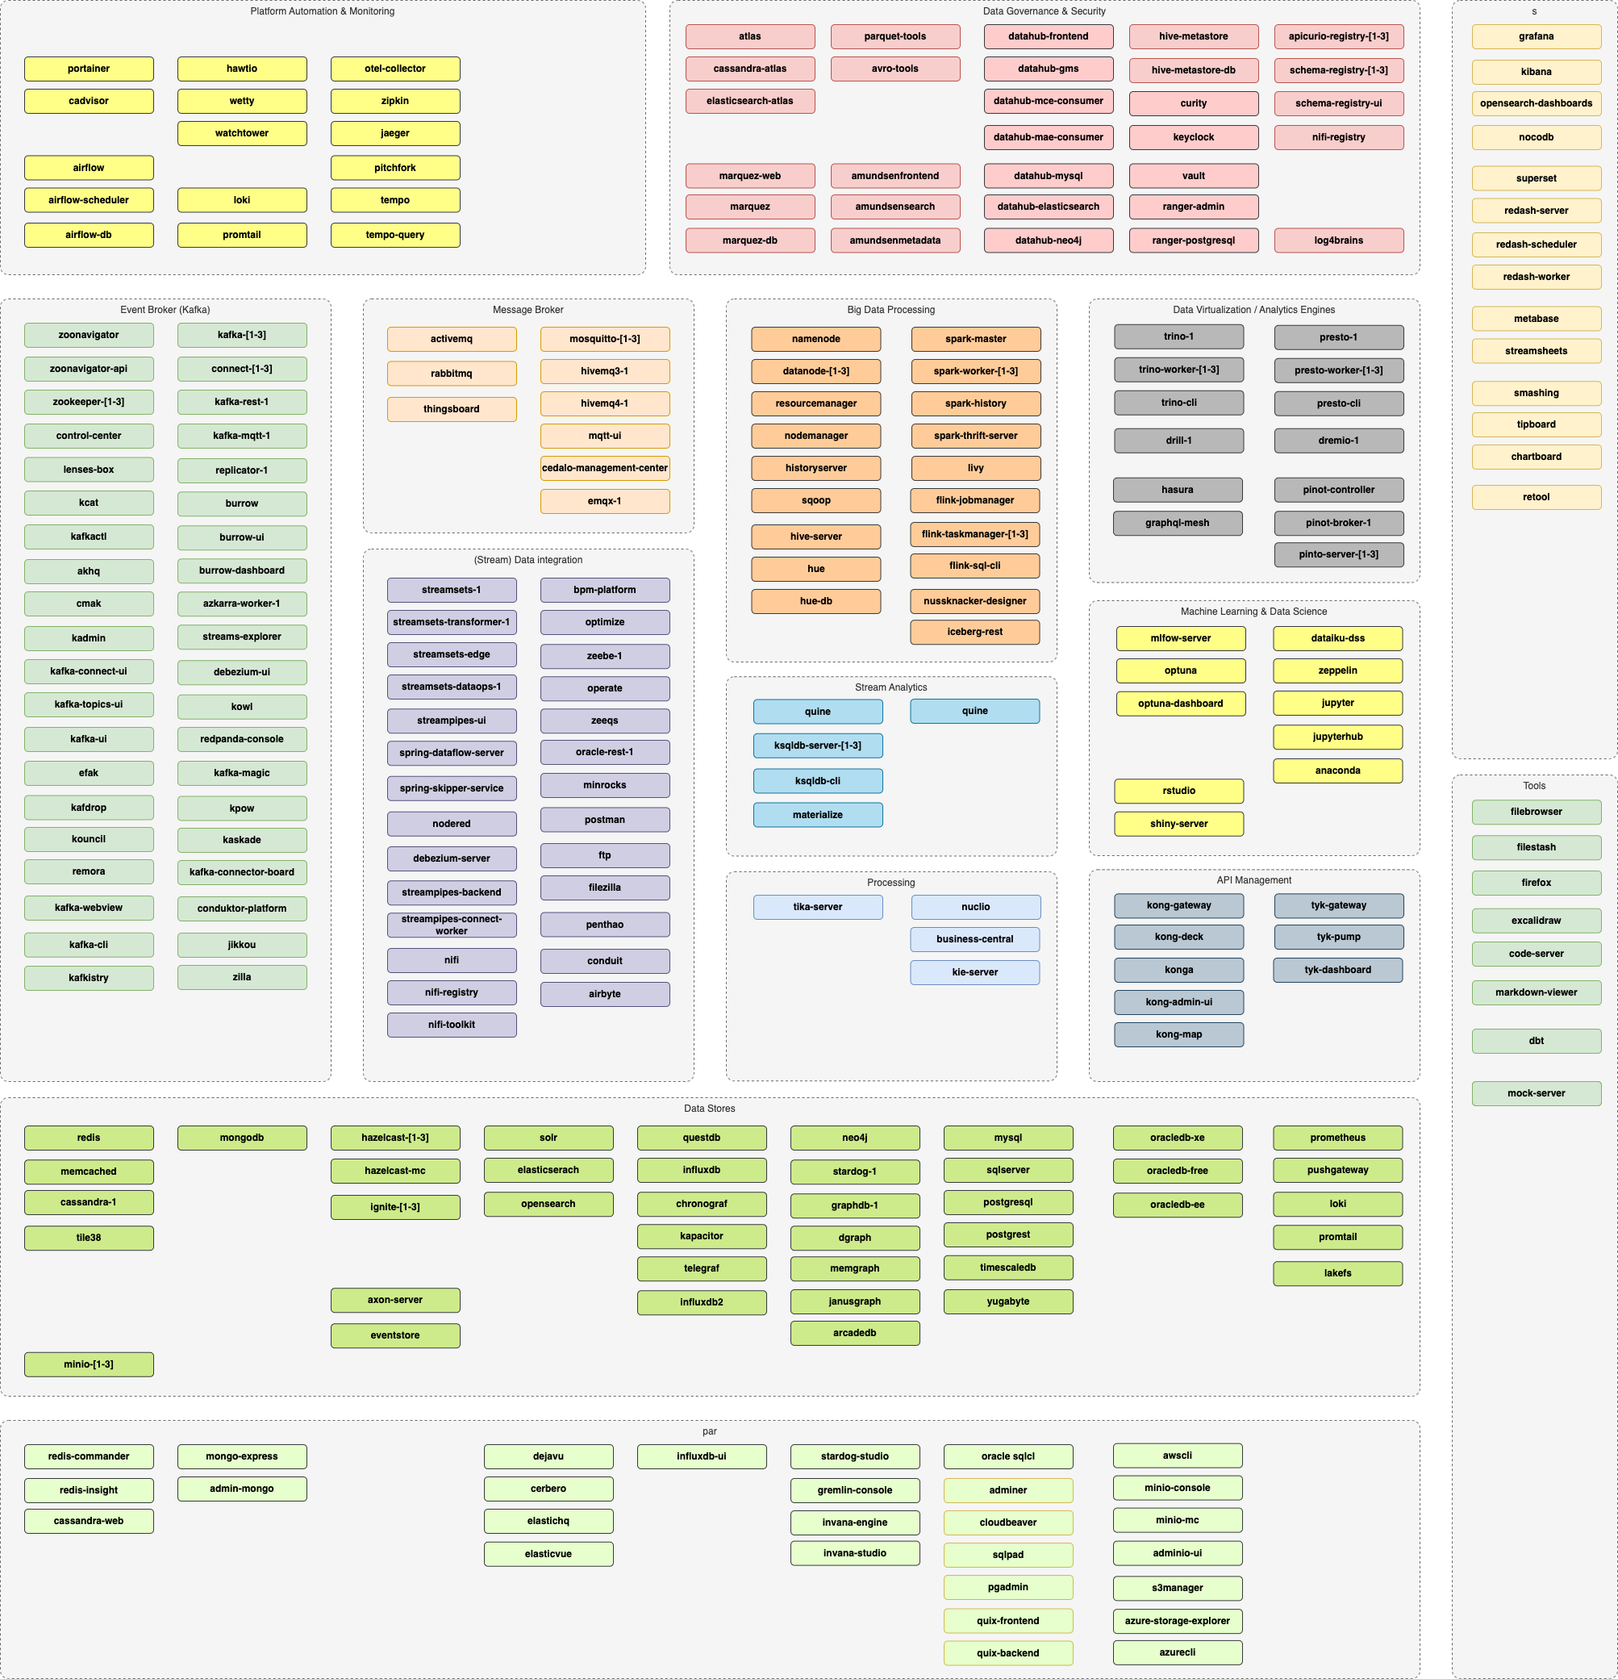
Second example
Try out or collaborate on an open source project: for example https://github.com/TrivadisPF/platys-modern-data-platform
Go to GitHub Repository
optionally: Fork
Open in Gitpod
Start working on it
Note: work locally (over Remote SSH)
to use desktop IDE (JetBrain or VS Code)
to work with multi server (web) applications (that refer to localhost)
Notes:
https://github.com/apache/superset

Slide 11
Gitpod – How to get it?
Gitpod
One of these:
GitHub account
GitLab account
BitBucket account
and go to https://gitpod.io
or: Self Hosted
https://www.gitpod.io/docs/configure/self-hosted/latest
Notes:
https://www.gitpod.io/docs/configure/self-hosted/latest

Slide 12
Gitpod - Costs
Standard workspace:
4 cores, 8GB RAM, 30 GB disk
=> 50 hours free / month €9 next 50 hours
Large workspace
8 cores, 16GB RAM, 50 GB disk
=> €19 / month for 100 hours

Slide 13
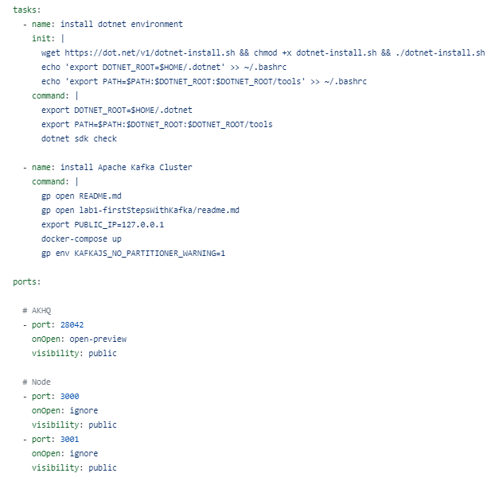
Configure Workspace using .gitpod.yml file
one time initialization of workspace
pull container images, download tar files, install packages
startup actions
run docker (compose), start database
set environment variables
open terminal windows
open editor windows
open ports and browser windows

Slide 14
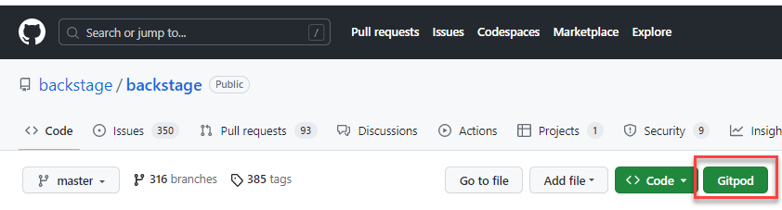
Extras
Browser Extension
Multiple workspaces – running in parallel
Workspace Snapshots – capture the state of a workspace
Share a running workspace & collaborate as if sitting behind the same laptop
Work locally on laptop over Remote SSH – Gitpod cloud == localhost

Slide 15


Benefits
Vanilla, clean, fast development environment for every project
Light weight laptops (or even tablet)
Easy management of quick to launch development environments
On boarding new team members
Try out and Participate in Open Source Projects
Rapid experimentation | training | R&D
More efficient use of energy (cloud based, consolidated)
Notes:
https://www.happierhuman.com/optimism-happiness/

Slide 16

But wait, there is more

Slide 17
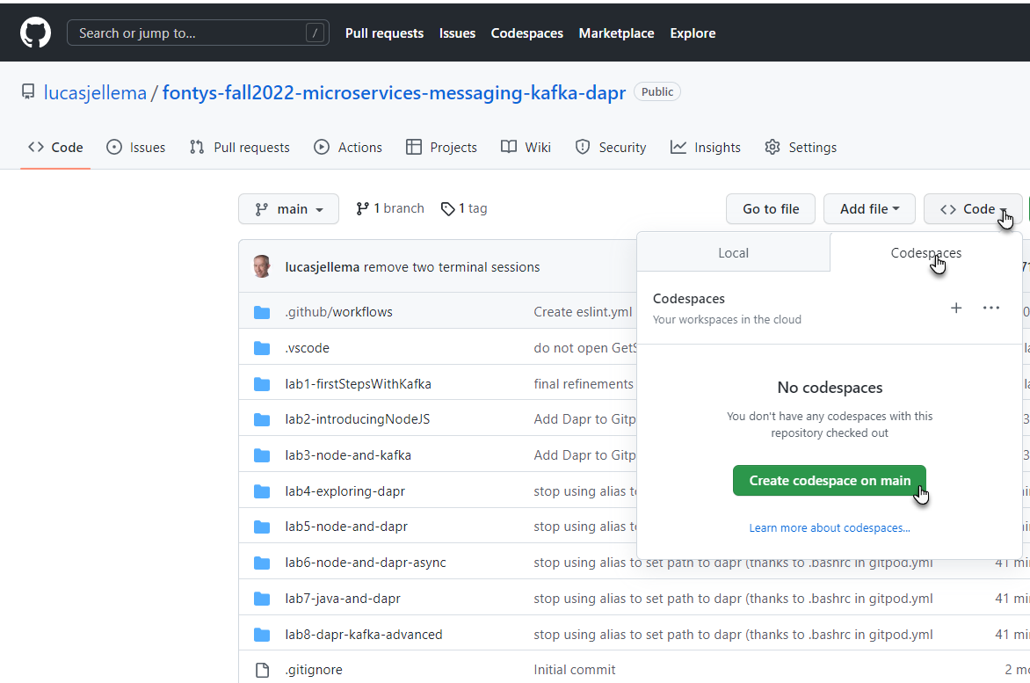
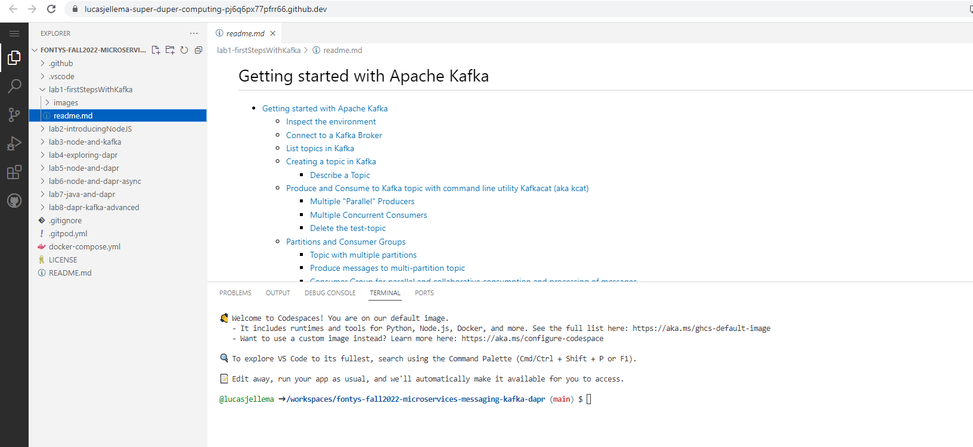

Slide 18
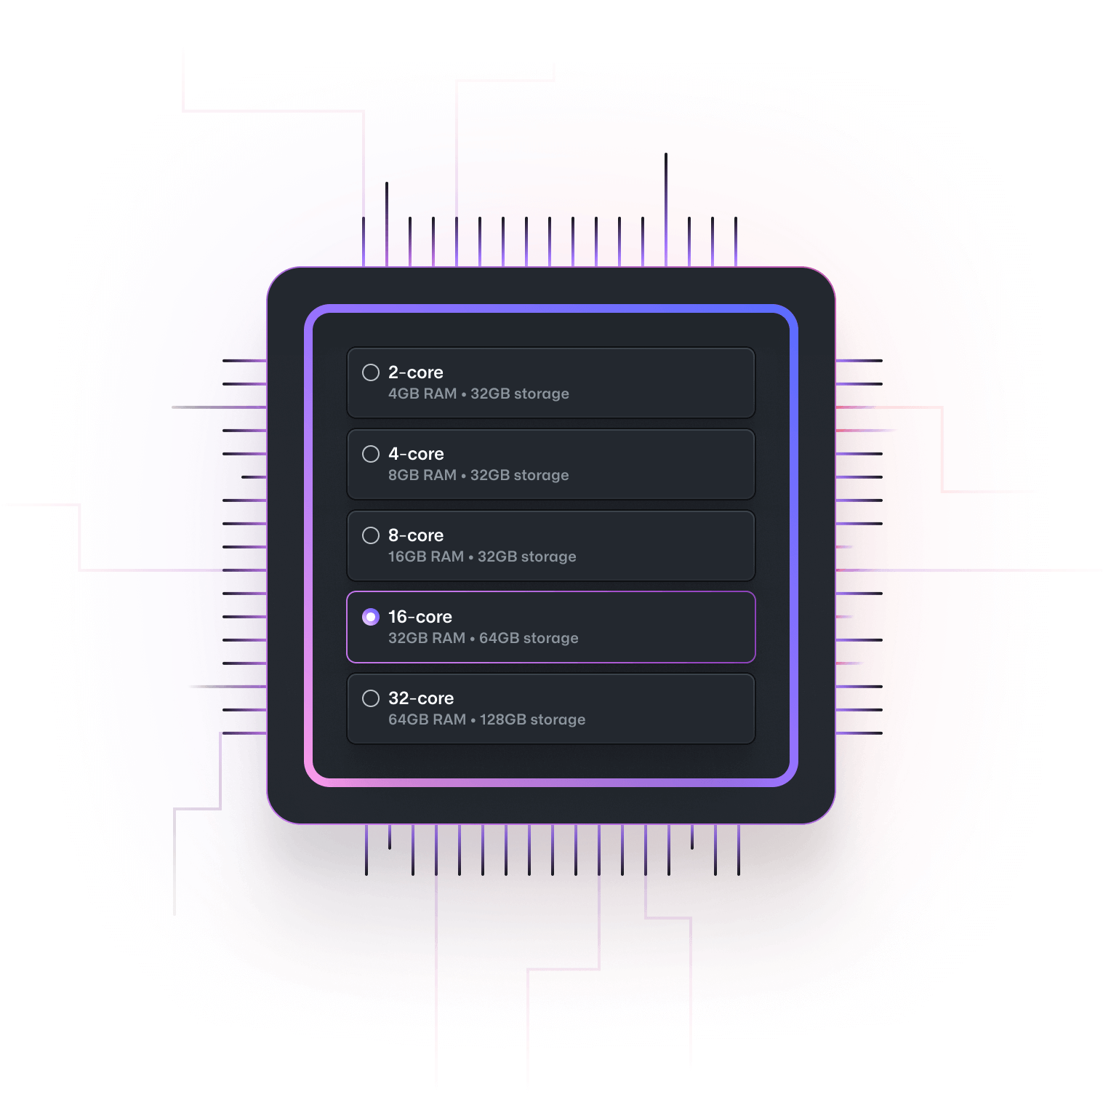
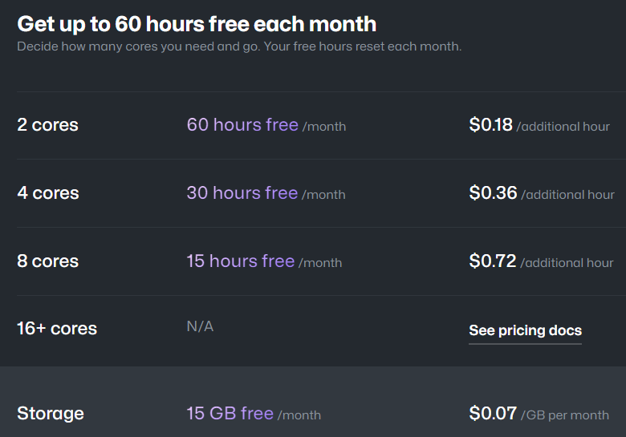
GitHub Codespaces – Options and Prices

Slide 19
Thank you for your attention I hope this was useful
lucas.jellema@conclusion.nl | technology.amis.nl | @lucasjellema | lucas-jellema

